Slide 1



Department of Computer Science and Engineering
Web development on Management of Food waste and Excess food
B.C. DHEVESH / 211420104065
M.P. DINESH KUMAR / 211420104068
Mrs.R.DEVI
Coordinator Name & Designation

Slide 2
Introduction
Food waste management is the process of reducing, recovering, and recycling food waste to minimize its negative impact on the environment and society.
According to the Food and Agriculture Organization (FAO) of the United Nations, one-third of all food produced globally is wasted each year, which amounts to about 1.3 billion tonnes.
The management of food waste involves several steps, including prevention, reduction, and diversion. Prevention involves reducing the amount of food waste generated by consumers and businesses through better planning, portion control, and food storage practices.

Slide 3
Objective of the Project
An important goal in our world today is to eliminate food waste by reutilizing available food sources within local communities and leftover food items in homes, restaurants, stores and food distribution centers.
A website is created for managing the food waste and excess food by converting the food waste into natural fertilizer and providing the excess food to hunger-needy people or to nearby orphanage homes.
This website has the information to do the process , either the process can be done on own or book an agent in this website , one of the agents collects the resources and do the further process.

Slide 4
Literature Survey
YEAR | TITLE AND JOURNAL | AUTHOR | DESCRIPTION | ADVANTAGES | DISADVANTAGES
2021 | SeVa: A Food Donation App for Smart Living | Christina Varghese, Drashti Pathak , Aparna S. Varde | focuses on creating an interesting mobile application (app) called SeVa that provides a ubiquitous platform wherein users can visualize available food resources in their local area and consequently gain access to food, thereby tackling two major issues, i.e. hunger and food waste. | Impacting AI in Smart Living for Smart Cities via ubiquitous access on mobile devices to knowledge about food, essential for health and sustainability.
2021 | Do VIR: Virtualizing Food Donation Distribution through Mobile Application and Cloud-Based Supply Chain Management | Divy Chhibber, Aditi Tripathi , Sandip Ray | includes mobile smartphone application together with cloud-based services to create a virtualized infrastructure for enabling precise, in-time food donation | In-time Donation,Precision Donation,Donor Community Engagement.

Slide 5
Literature Survey
YEAR | TITLE AND JOURNAL | AUTHOR | DESCRIPTION | ADVANTAGES | DISADVANTAGES
2020 | Human Health Risks Concerning Food Waste Management | Elena-Diana Ungureau-Comanit1, Ersilia Lazar Cosbuc1, Petronela Cozma1, Camelia Smaranda1, Maria Gavrilescu1,2 | to identify the human health’s risk factors due to inadequate food waste management and recommend best management alternatives for the recovery and recycling of food waste. | Analyze and highlight the best management alternatives for the recovery and recycling valuable components of food waste.
2020 | FoodX, a System to Reduce Food Waste | Shinta Oktaviana R, Diana Ambarwati Febriani, Intan Yoshana, LR. Payanta | The Community collects excess food from eligible donor consumption to be distributed to people in Need (with and without volunteer),.

Slide 6
Existing System
Here, users can visualize available food resources in their local area and consequently gain access to food, thereby tackling two major issues, i.e. hunger and food waste during pandemic situations(covid).
To access this app user requires mobile and internet as the users who are in need of food.
If food suppliers intend to donate food through the app, they can enter the type of food they would donate, the quantity of the item(s), date of expiry and so on.

Slide 7
Problem Statement
Food waste is a growing concern in today's world, with an estimated one-third of all food produced for human consumption going to waste.
This not only has economic implications but also has significant environmental and social impacts. Food waste contributes to greenhouse gas emissions, depletes natural resources, and exacerbates food insecurity.
Effective food waste management is essential to address this problem, which involves identifying the sources of food waste, implementing strategies to prevent it, and finding sustainable ways to dispose of it.
The problem statement for food waste management, therefore, would be how to reduce food waste at its source, and how to manage it effectively to minimize its impact on the environment and society.

Slide 8
Proposed System
This system , not only includes donating food only during pandemic(covid).
Whenever , there is some excess food that can be available at where any large amount of cooking and dining takes place , those can be donated to nearby homes or the needy people . The information of the homes will be in the web page , either you can do or if you book an agent in the web page , the agent will come and collect the food and deliver to the nearby home(s).
This system also helps in managing the food waste by converting most the food waste into manure , which can be used as natural fertilizer to crops/plants , but some category should definitely be disposed properly.
The process of converting the food waste into manure is the web page ,either you can do or if you book an agent in the web page , the agent will come and collect the resources and do the further processes.

Slide 9
Module
Managing food waste and excess food consists of 6 modules. They are
Food waste and self-manage module.
Excess food and self-manage module.
Both and self-manage module.
Food waste and Book agent module.
Excess food and Book agent module.
Both and Book agent module.

Slide 10
Software / Hardware used
Windows 11
HTML
CSS
Java script
VS Code

Slide 11
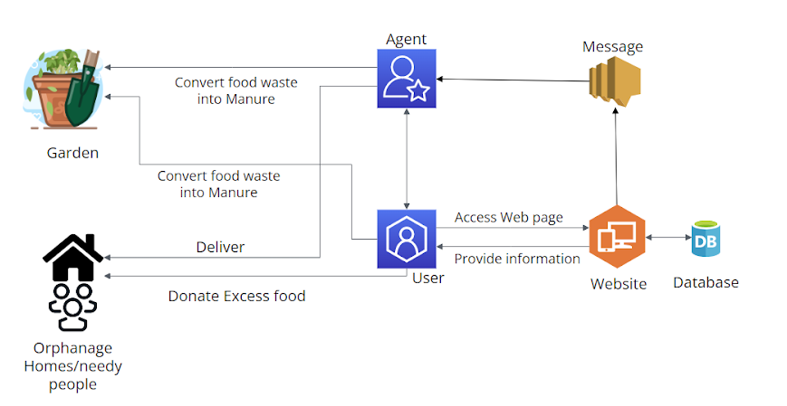
Architecture / Methodology used

Slide 12
System Design - Flow Chart/DFD/ER
Start
Self-manage/
Book managing agent
Select Food Waste/Excess Food
Self-Manage
Show Self-managing ways
Book agent
End
Enter details for booking
Select an Agent and send the details
Agent arrives and collect the resources

Slide 13
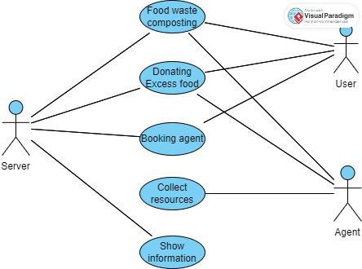
System Design - Flow Chart/DFD/ER

Slide 14
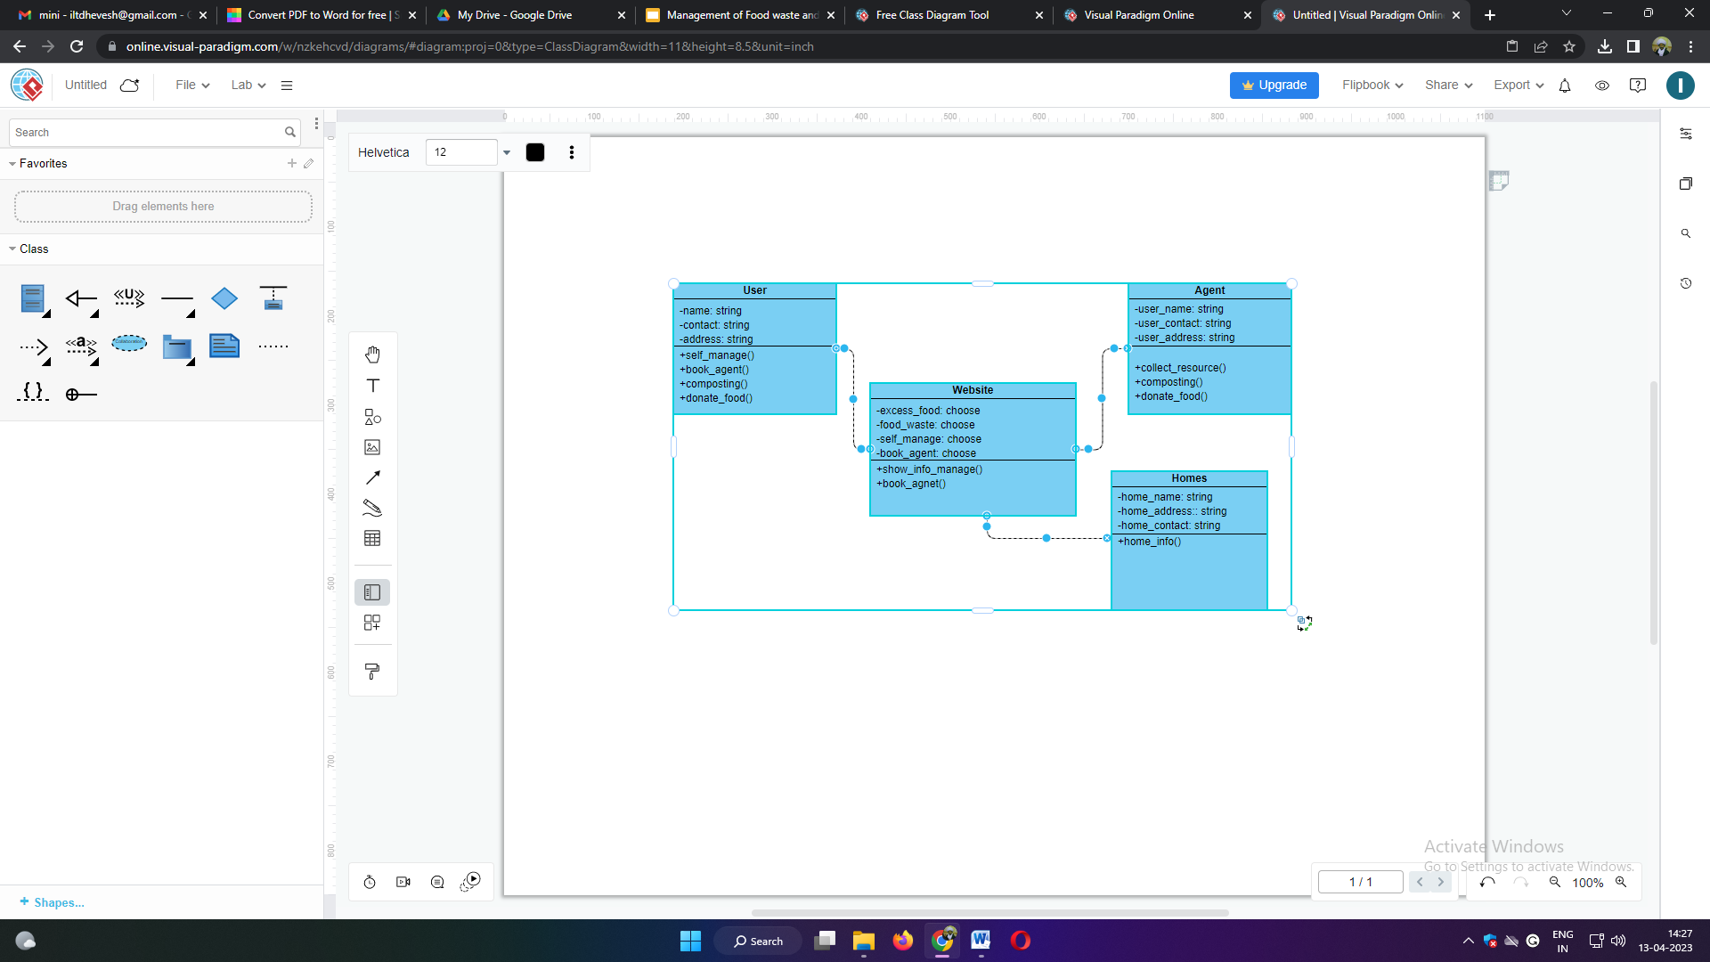
System Design - Flow Chart/DFD/ER

Slide 15
Module Description
Food waste and self-manage module
Shows information how to deal with Food waste
Excess food and self-manage module
2. Shows information how to deal with Excess food
Both and self-manage module
3. Shows information how to deal with both Food waste and Excess food
Food waste and Book agent module
4. Can enter Name , Number and Address to book an agent.
5. Click submit to book an agent for Food waste.

Slide 16
Module Description
Excess food and Book agent module
6. Can enter Name , Number and Address to book an agent.
7. Click submit to book an agent for Excess food.
Both and Book agent module
8. Can enter Name , Number and Address to book an agent.
9. Click submit to book an agent for both Food waste and Excess food.

Slide 17
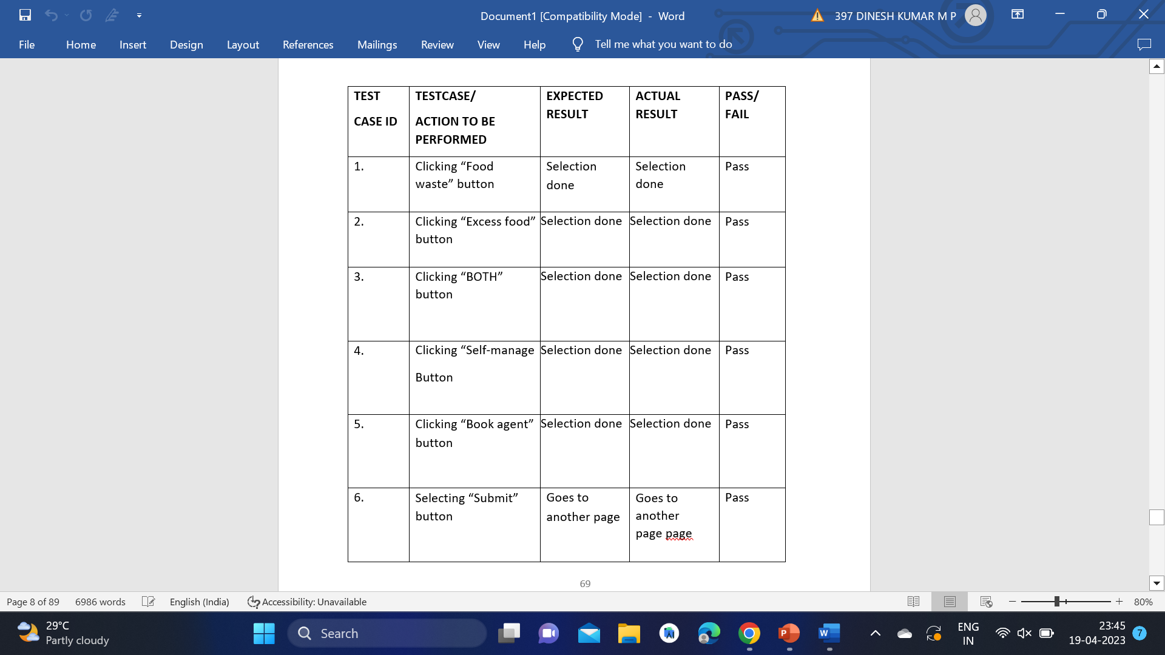
Testing /Performance Evaluation / Results

Slide 18
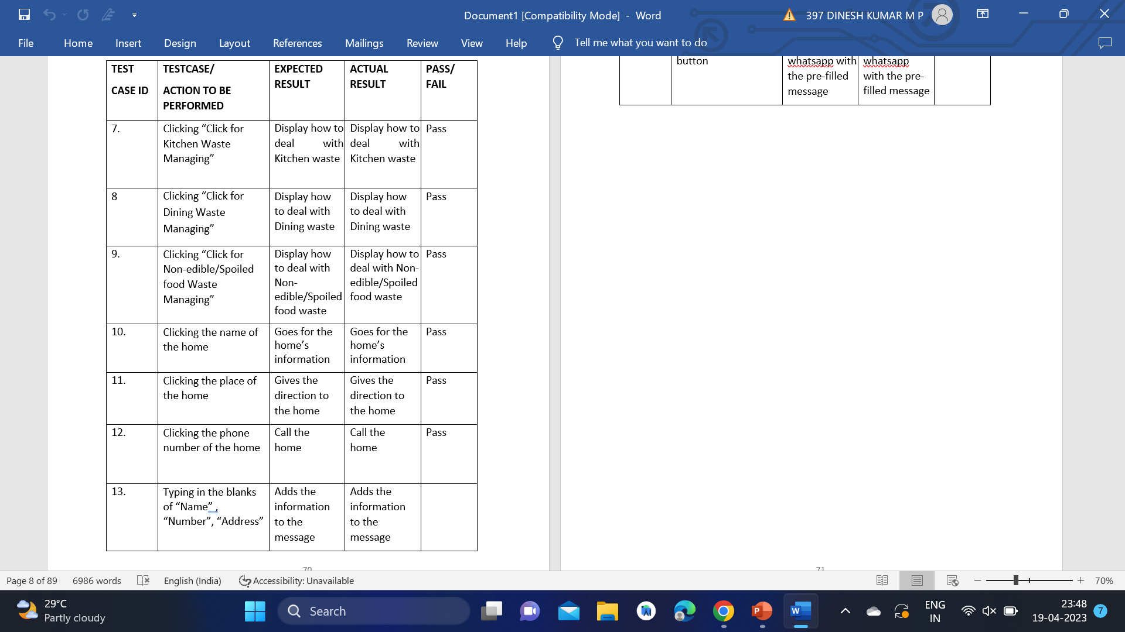
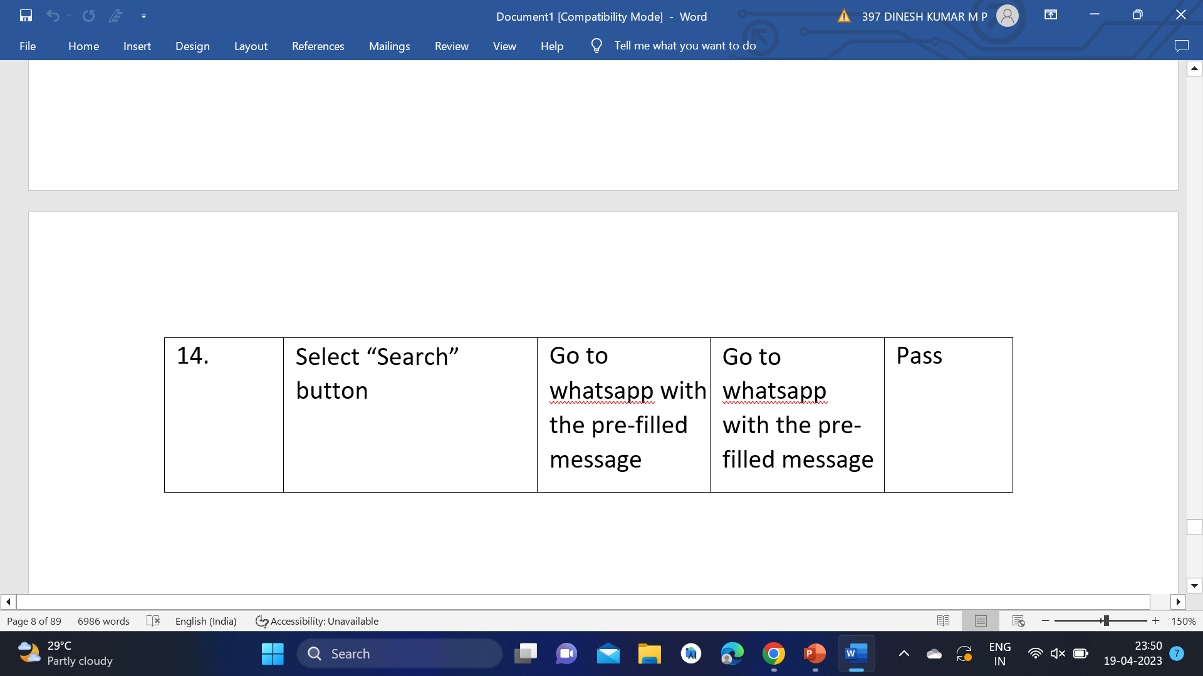
Testing /Performance Evaluation / Results

Slide 19
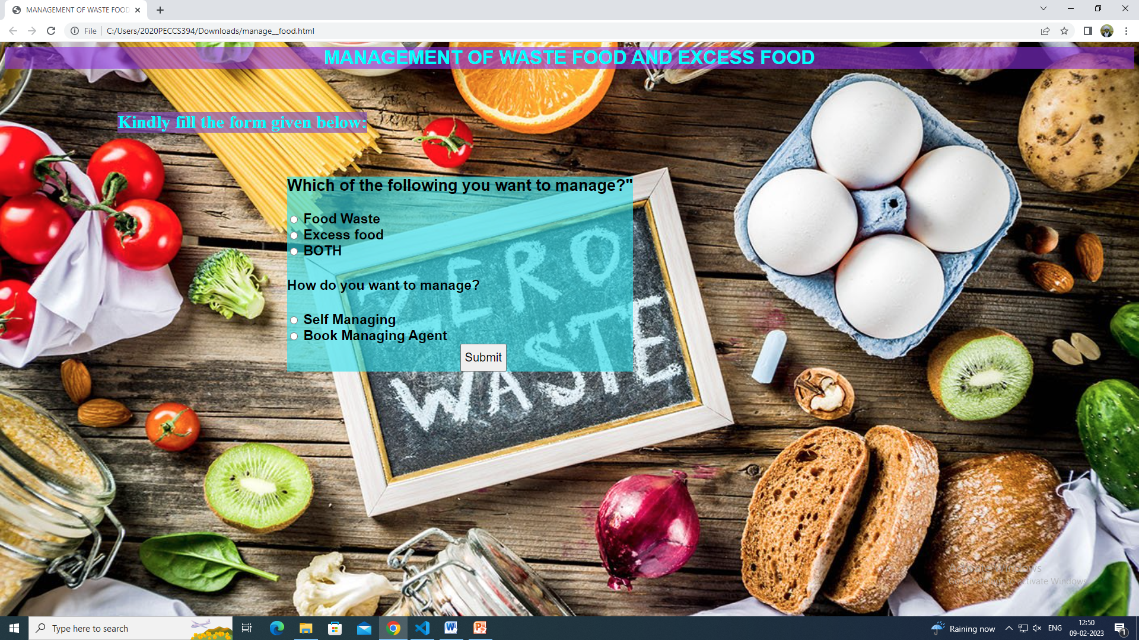
Screen Shots
Slide 20 to 22

Slide 20
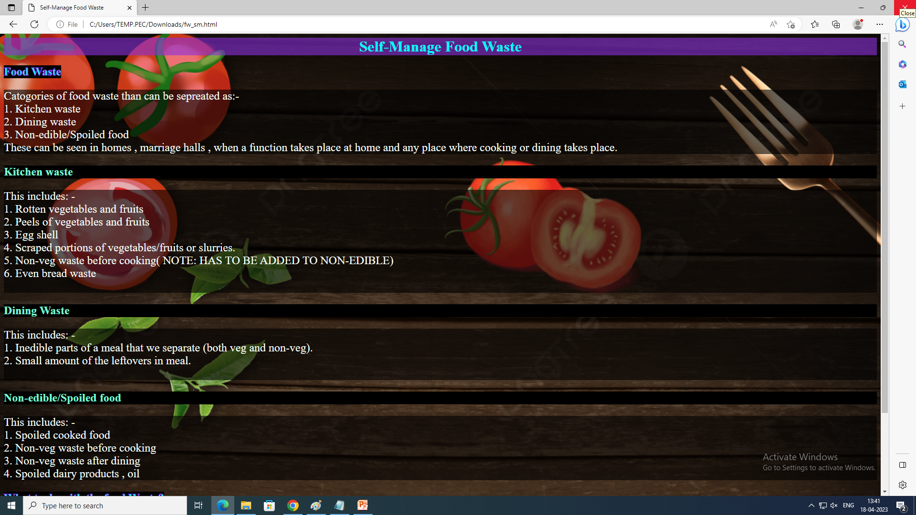
Screen Shots

Slide 21
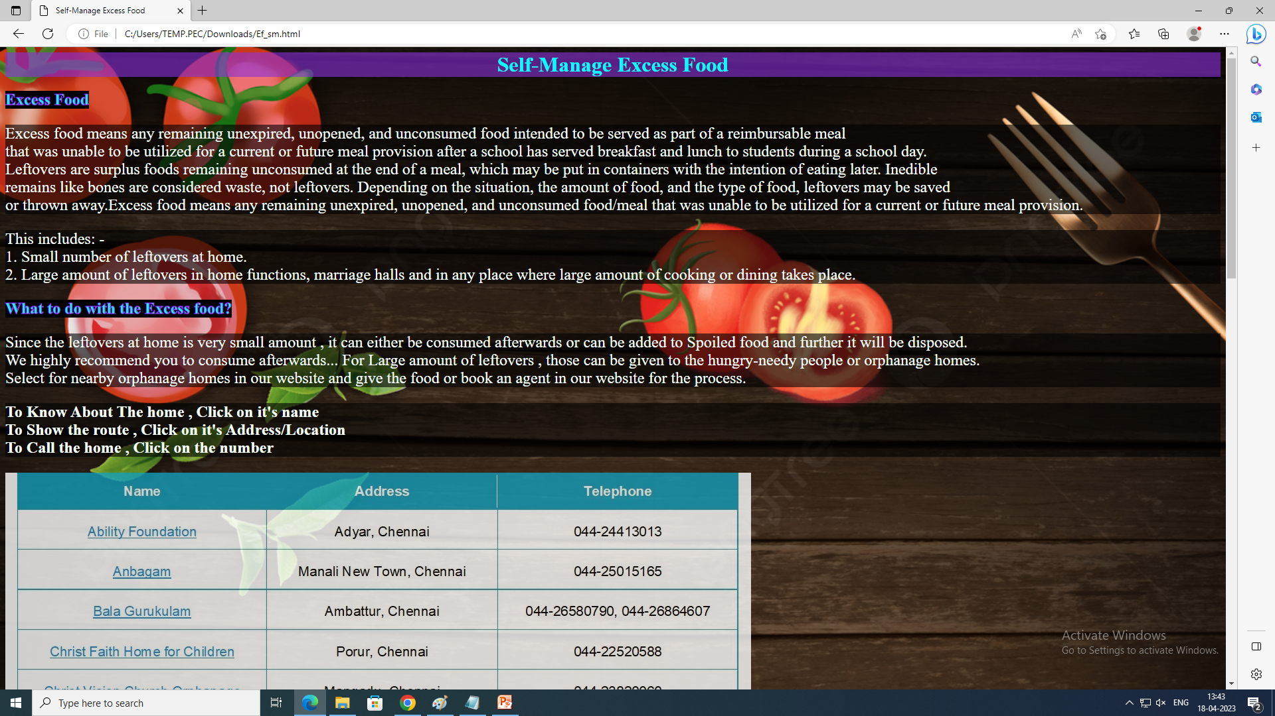
Screen Shots

Slide 22
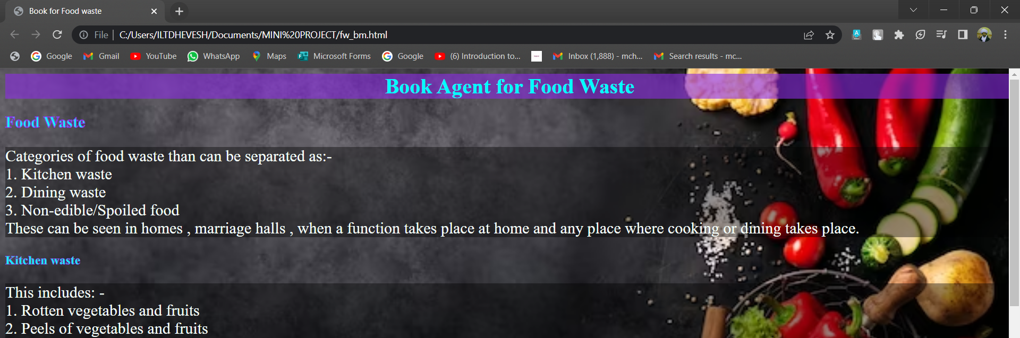
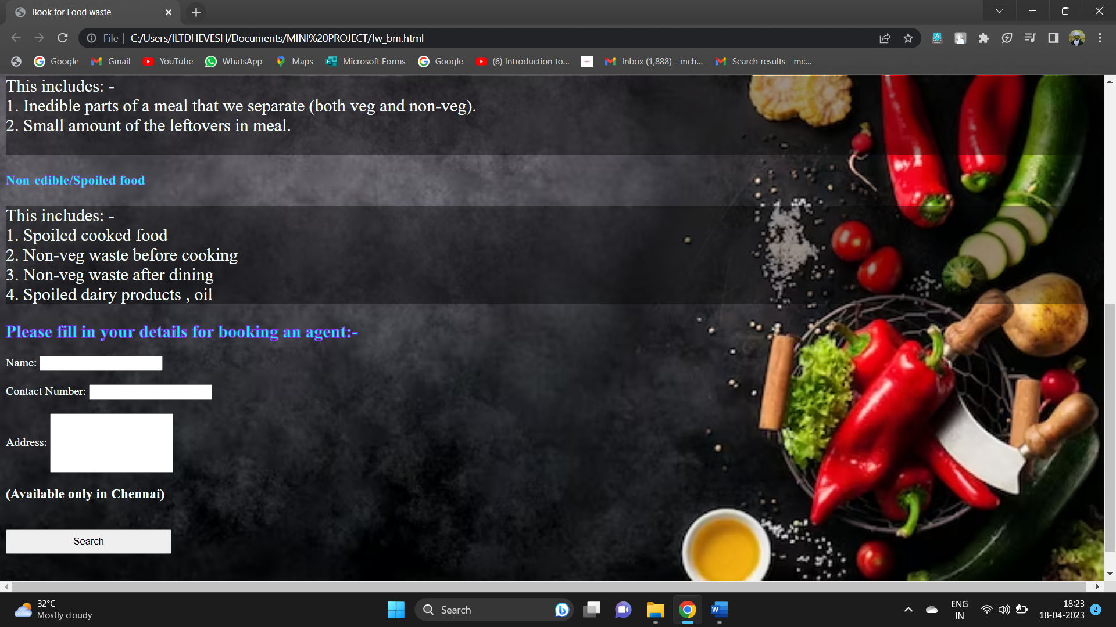
Screen Shots

Slide 23
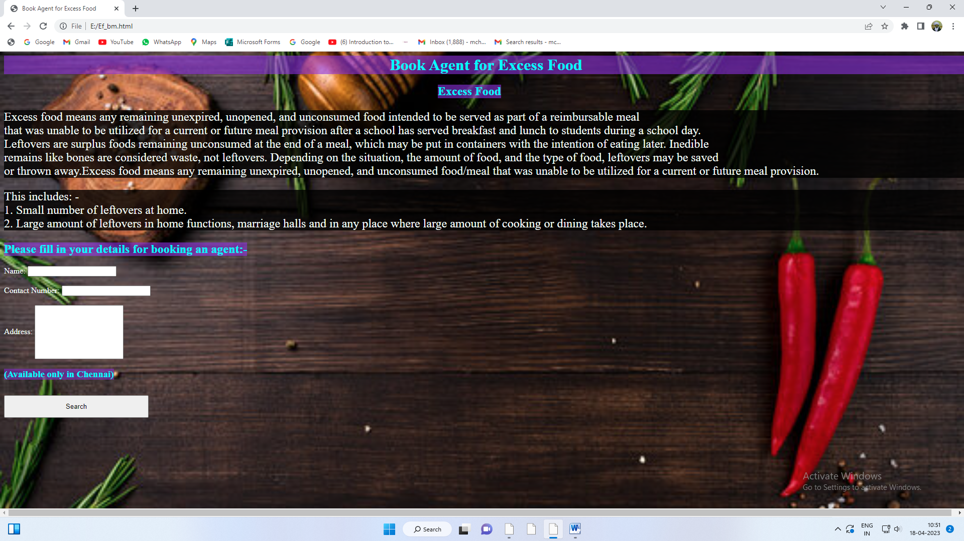
Screen Shots

Slide 24
Conclusion / Feature Enhancement
This page says that most of the food wastes can be reused for providing good nutrition to plants as a natural fertilizer by composting them. But some should be disposed in a proper way . This page also helps in donating the excess food to given to the hungry-needy people or nearby orphanage homes.
Thus by using natural fertilizer to the plants , the plants gives us healthy food. Therefore this helps to be eco-friendly and to be good as humans with humanity by providing food to the needy people.

Slide 25
Reference Paper/ URL
[1]hsph.harvard,https://www.hsph.harvard.edu/nutritionsource/sustainability/food-waste/
[2]lawinsider,https://www.lawinsider.com/dictionary/excessfood#:~:text=Excess%20food%20means%20any%20
remaining,students%20during%20a%20school%20day
[3] zipinventory, https://zipinventory.com/en/food-waste-management.html
[4] futurelearn., https://www.futurelearn.com/info/courses/an-introduction-to-food-science/0/steps/159644
[5] w3schools, https://www.w3schools.com/html/
[6] javatpoint, https://www.javatpoint.com/html-tutorial
[7] w3schools, https://www.w3schools.com/js/
8] Divy Chhibber, Aditi Tripathi, Sandip Ray, “Do VIR: Virtualizing Food Donation Distribution through Mobile Application and Cloud-Based Supply Chain Management”, 2021 IEEE International Conference on Consumer Electronics (ICCE).
[9] Elena-Diana Ungureau-Comanit1, Ersilia Lazar Cosbuc1, Petronela Cozma1, Camelia Smaranda1, Maria Gavrilescu1,2, “Human Health Risks Concerning Food Waste
Management”, Grigore T. Popa University of Medicine and Pharmacy, Web Conference, Romania, October 29-30, 2020.
[10] Shinta Oktaviana R, Diana Ambarwati Febriani, Intan Yoshana, LR. Payanta, “FoodX, a System to Reduce Food Waste”, 2020 3rd International Conference on Computer and Informatics Engineering (IC2IE).

